Slide 1
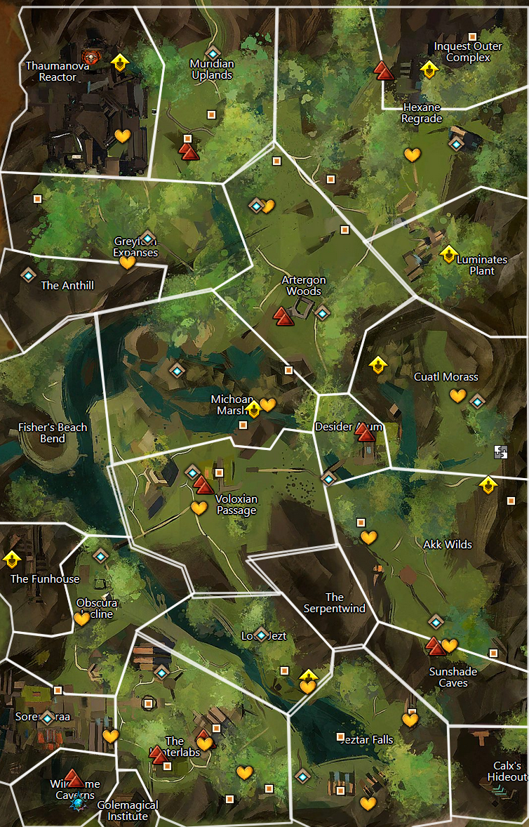
15
10
1-zojja-
14
13
1-welcome inventor
2-brain washing
3-interrupting research
4-not even the frogs are safe, note about fun house
5-plot to disrupt power to metrica
6-too busy with the rats
7-zojja drops in to send a message, pick up a crafting profesion. She heard from a frog about a hidden entrance. Go ask for more details
8-frogs talk about how hunters north of anthill report inquest disappear into the wall
9-assault the complex to see about notes on the power grid plan
10-find hologram of assault plan, return and head over to luminates plant
11-keep powergid safe
12-turrets online, inquest complex to north threatens
13-recover note mentioning thaumanuova
14-stolen core taken north, theft covered up by toxins from failed experiment
15-go find the stolen reactor core
9
11
12
8
7
6
5
4
1
2
3

Slide 2

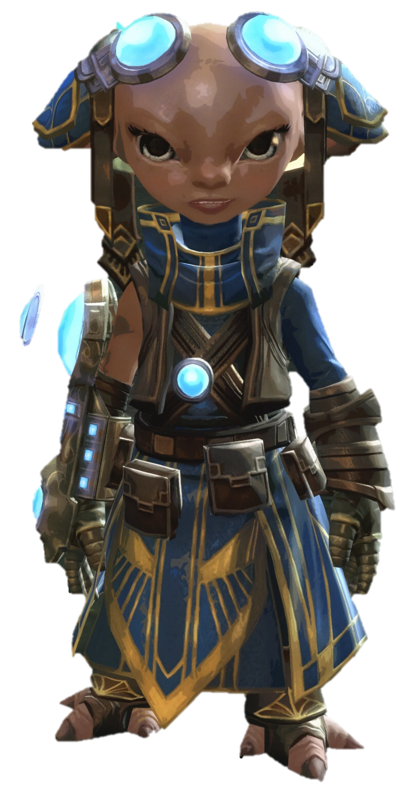
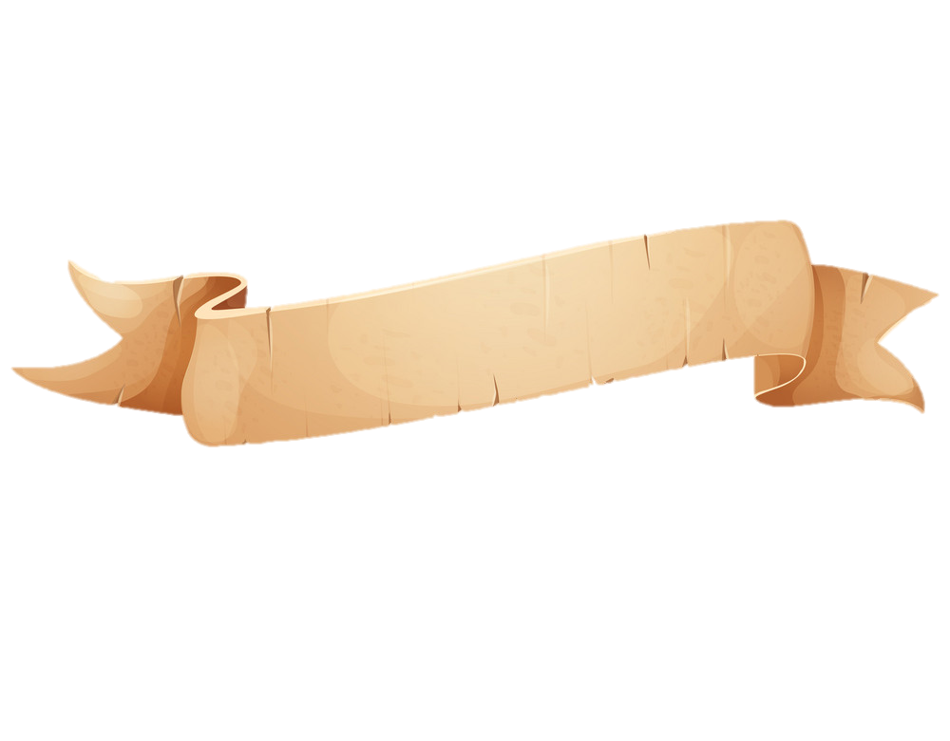
Text
text.
1
Zojja

Slide 3
text.
text.
Text
text.
1
2

Slide 4
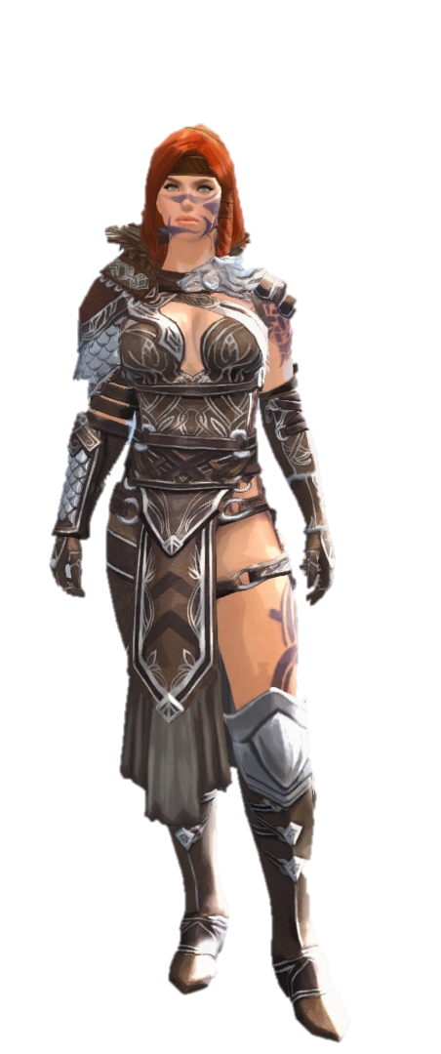
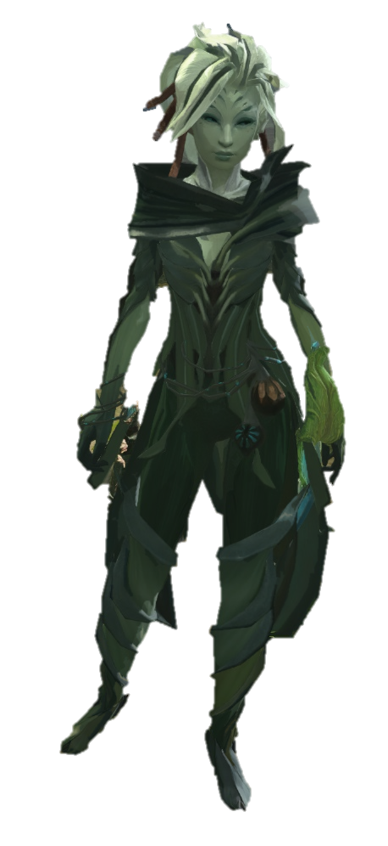

Slide 5
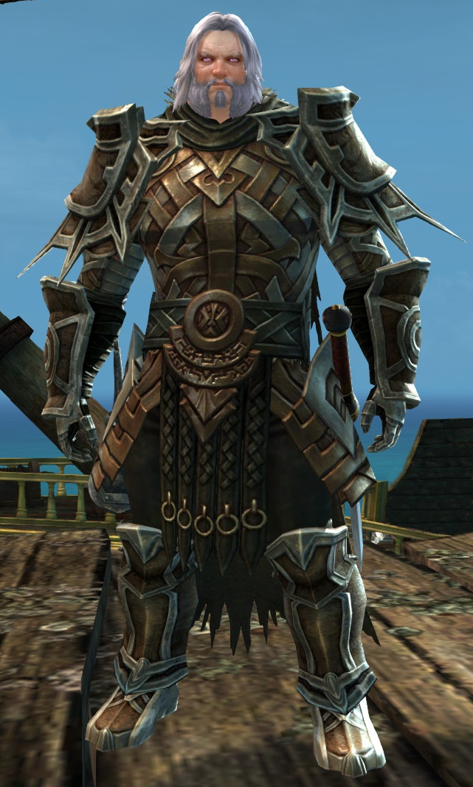
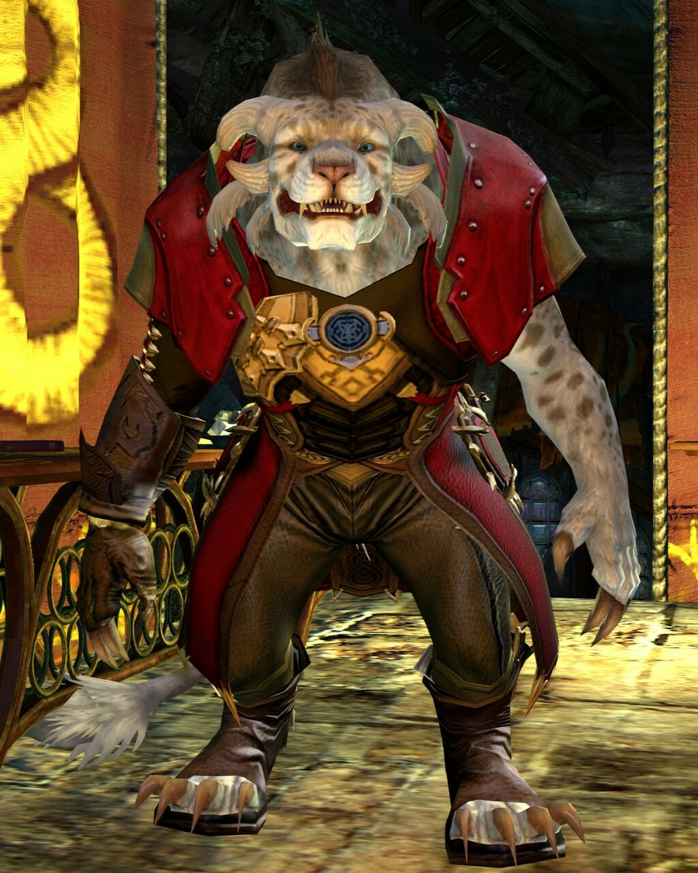
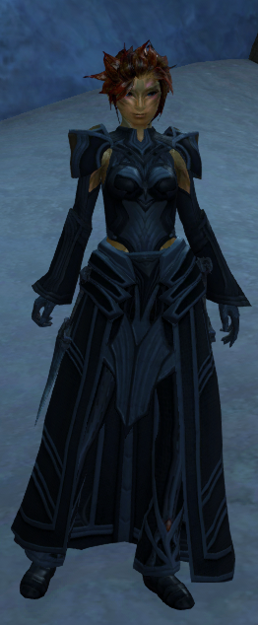

Slide 6
